Slide 1
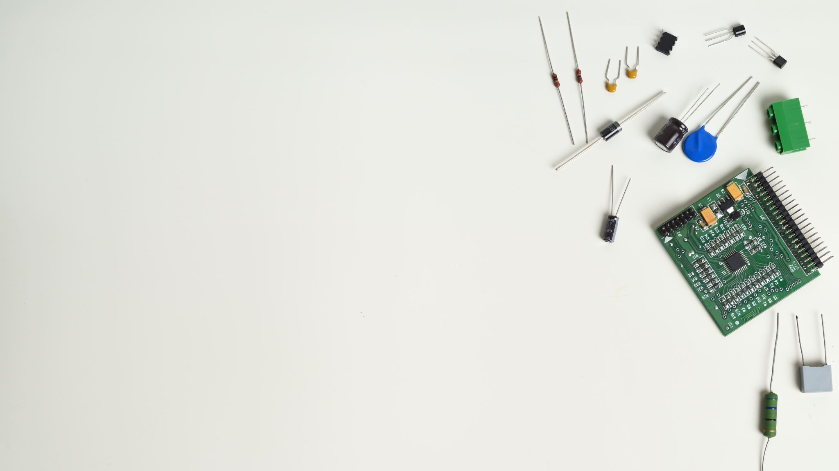
IOT(18EC64)-MODULE-2
Nischitha S
Assistant Professor
Department of ECE
BGSIT

Slide 2
MICROSOFT TEAMS-->TEAMS--> INTERNET OF THINGS--> FILES--> CLASS MATERIALS--> IOT(18EC64) MODULE-1

Slide 3
SMART OBJECTS
Smart objects are any physical objects that contain embedded technology to sense and/or interact with their environment in a meaningful way by being interconnected and enabling communication among themselves or an external agent
FUNDAMENTAL BUILDING BLOCKS IF IOT NETWORK
-- Sensors
--Actuators
--Smart Objects

Slide 4
SENSOR
Physical quantity-->digital representation
Digital representation-->transformation into useful data
Sensors can be readily embedded in any physical objects that are easily connected to the Internet by wired or wireless networks, they can interpret their environment and make intelligent decisions

Slide 5
Sensors
Active or passive
Invasive or non-invasive
Absolute or relative
Area of application
How sensors measure
What sensors measure

Slide 6
The physical phenomenon a sensor is measuring

Slide 7
Sensors in smart phone

Slide 8
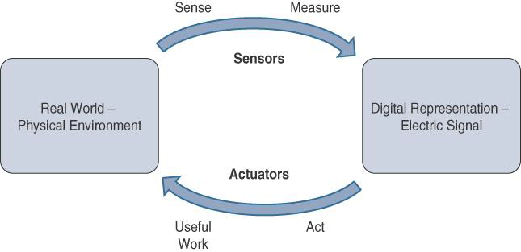
Actuators
Complements to sensor

Slide 9
Actuators Classification
Type of motion
Power
Binary or continuous
Area of application
Type of energy

Slide 10
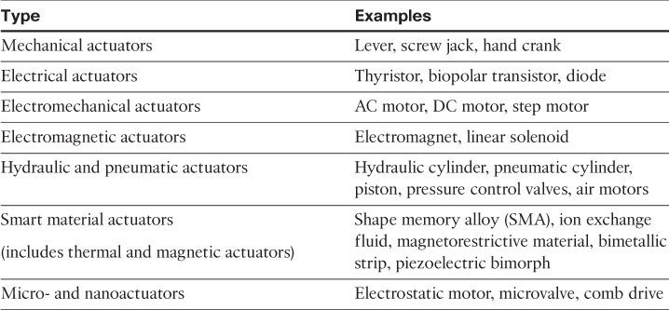
Actuator Classification by Energy Type

Slide 11
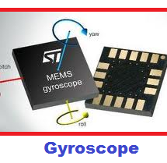
MEMS
Micro-electro-mechanical system

Slide 12
Smart object defining characteristics
Processing Unit
Sensor(s) and /or actuator(s)
Communication Device
Power Source:

Slide 13
Trends in Smart Objects
Size is decreasing:
Power consumption is decreasing
Processing power is increasing
Communication capabilities are improving
Communication is being increasingly standardized

Slide 14
Sensor Networks
Sensor/Actuator Network-SANET,,, Example: Smart home
ADVANTAGES
Greater deployment flexibility (especially in extreme environments or hard-to-reach places)
Simpler scaling to a large number of nodes
• Lower implementation costs
• Easier long-term maintenance • Effortless introduction of new sensor/actuator nodes • Better equipped to handle dynamic/rapid topology changes

Slide 15
DISADVANTAGES
Potentially less secure (for example, hijacked access points)
Typically, lower transmission speeds
Greater level of impact/influence by environment

Slide 16
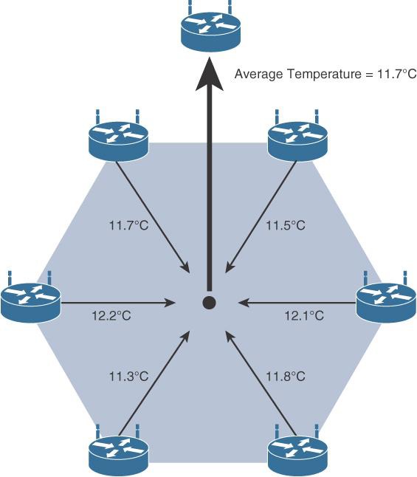
WIRELESS SENSOR NETWORKS(WSN)
Limited processing power
Limited memory
Lossy communication
Limited transmission speeds
Limited power
Data aggregation
Communication Protocols for Wireless Sensor network

Slide 17
Connecting Smart Objects

Slide 18
Frequency Bands
International Telecommunication Union (ITU) and the Federal Communications Commission (FCC)
licensed and unlicensed bands
For IoT access, these are the most well-known ISM bands:
• 2.4 GHz band as used by IEEE 802.11b/g/n Wi-Fi
• IEEE 802.15.1 Bluetooth
• IEEE 802.15.4 WPAN

Slide 19
IEEE 802.15.4, 802.15.4g, and 802.11ah, and LPWA technologies use Sub-GHZ
The most well-known ranges are centered on 169 MHz, 433 MHz, 868 MHz, and 915 MHz.
The 868 MHz band is applicable to IoT access technologies such as IEEE 802.15.4 and 802.15.4g, 802.11ah, and LoRaWAN

Slide 20
Power Consumption
Battery-powered--> more flexibility
IOT wireless access technology--> low power consumption and connectivity for battery powered devices
Low-Power Wide-Area

Slide 21
Toplogy

Slide 22
Constrained nodes

Slide 23
IOT Access Technologies
IEEE 802.15.4
o Home and building automation
Automotive networks
Industrial wireless sensor networks
Interactive toys and remote controls
Interference and multipath fading occur with IEEE 802.15.4 because it lacks a frequency-hopping technique

Slide 24
Protocols based on IEEE802.15.4

Slide 26
ZIGBEE

Slide 27
ZIGBEE IP

Slide 28
802.15.4 PHYSICAL AND MAC LAYER
The original IEEE 802.15.4-2003 standard specified only three PHY options based on direct sequence spread spectrum (DSSS) modulation
The original physical layer transmission options were as follows:
2.4 GHz, 16 channels, with a data rate of 250 kbps
915 MHz, 10 channels, with a data rate of 40 kbps
868 MHz, 1 channel, with a data rate of 20 kbps

Slide 29
IEEE 802.15.4-2006, 802.15.4-2011, and IEEE 802.15.4-2015 introduced additional PHY communication options
OQPSK PHY
BPSK PHY
ASK PHY

Slide 30
IEEE 802.15.4 PHY FORMAT

Slide 31
802.15.4 MAC layer functions
Network beaconing for devices acting as coordinators (New devices use beacons to join an 802.15.4 network)
PAN association and disassociation by a device
Device security o Reliable link communications between two peer MAC entities
The MAC layer achieves these tasks by using various predefined frame types. In fact, four types of MAC frames are specified in 802.15.4:

Slide 32
Data frame: Handles all transfers of data
Beacon frame: Used in the transmission of beacons from a PAN coordinator
Acknowledgement frame: Confirms the successful reception of a frame
MAC command frame: Responsible for control communication between devices

Slide 33
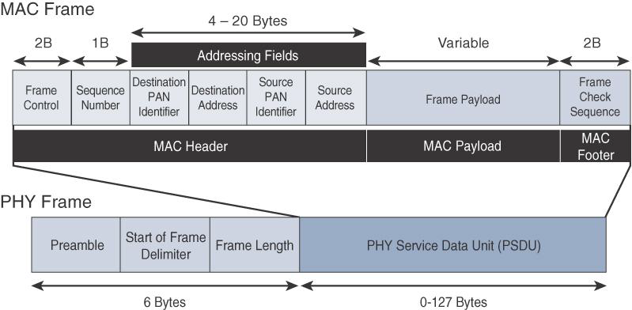
IEEE 802.15.4 MAC FORMAT

Slide 34
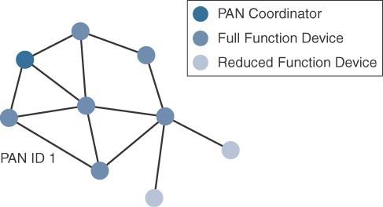
TOPOLOGY

Slide 35
SECURITY

Slide 36
IEEE 802.15.4g and 802.15.4e
o Distribution automation and industrial supervisory control and data acquisition (SCADA) environments for remote monitoring and control
Public lighting
Environmental wireless sensors in smart cities
Electrical vehicle charging stations
Smart parking meters Microgrids
Renewable energy.
Standardization and Alliances:

Slide 37
Physical layer
--Multi-Rate and Multi-Regional Frequency Shift Keying (MR-FSK):
--Multi-Rate and Multi-Regional Orthogonal Frequency Division Multiplexing(MR-OFDM)
--Multi-Rate and Multi-Regional Offset Quadrature Phase-Shift Keying (MR-O-QPSK)

Slide 38
MAC layer
--Time slotted channel hopping(TSCH)
--Information elements
--Enhanced beacons
--Enhanced beacon requests
--Enhanced acknowledgement

Slide 40
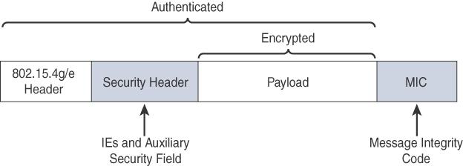
TOPOLOGY
Security

Slide 41
IEEE 1901.2a
Wired technology
Narrowband Power Line Communication
-Smart metering
-Distribution automation
-public lighting
- Electric vehicle
-Microgrids
-Renewable energy

Slide 42
Standardization and Alliance
-NB-PHY and MAC
-802.15.4e information fields elements usage
-Home plug alliance

Slide 43
Physical layer
NB-PLC Frequency Bands

Slide 44
MAC Layer

Slide 45
Topology
- Mesh
Security

Slide 46
IEEE 802.11ah
Wireless
Sub-GHz version of Wi-Fi
Standardization and Alliance
Physical layer
---868–868.6 MHz for EMEAR, 902–928 MHz and associated subsets for North America and Asia-Pacific regions, and 314–316 MHz, 430–434 MHz, 470–510 MHz, and 779–787 MHz for China.
-- OFDM modulation, IEEE 802.11ah uses channels of 2, 4, 8, or 16 MHz

Slide 47
MAC layer
Number of devices
MAC header
Null data packet (NDP) support
Grouping and sectorization
Restricted access window (RAW)
Target wake time (TWT)
Speed frame exchange

Slide 48
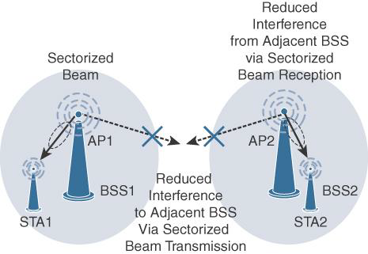
TOPOLOGY

Slide 49
Security
- Similar to IEEE 802.11 specification
Competitive technologies
- IEEE 802.15.4 and IEEE 802.15.4e

Slide 50
LoRa WAN

Slide 51
PHYSICAL LAYER
use of the main unlicensed sub-GHz frequency bands of 433 MHz, 779–787 MHz, 863–870 MHz, and 902–928 MHz, as well as regional profiles for a subset of the 902–928 MHz bandwidth.
For example, Australia utilizes 915–928 MHz frequency bands, while South Korea uses 920–923 MHz and Japan uses 920–928 MHz.
A LoRa gateway is deployed as the center hub of a star network architecture.
An important feature of LoRa is its ability to handle various data rates via the spreading factor.

Slide 52
MAC LAYER
Three classes of LORA WAN devices
- Class A
-Class B
Class C

Slide 53
High level LoRa WAN MAC frame format

Slide 54
In version 1.0.x, LoRa WAN utilizes six MAC message types
Join request
Join accept messages
Unconfirmed data up/down message
Confirmed data up/down message
Uplink messages
Downlink messages

Slide 55
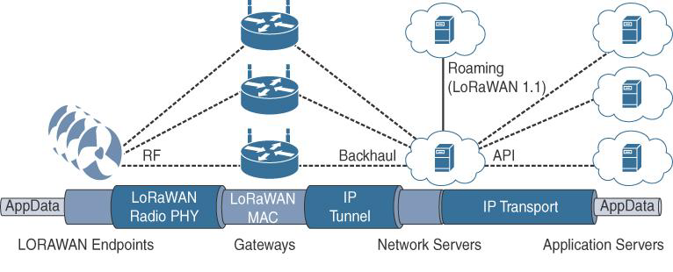
TOPOLOGY

Slide 56
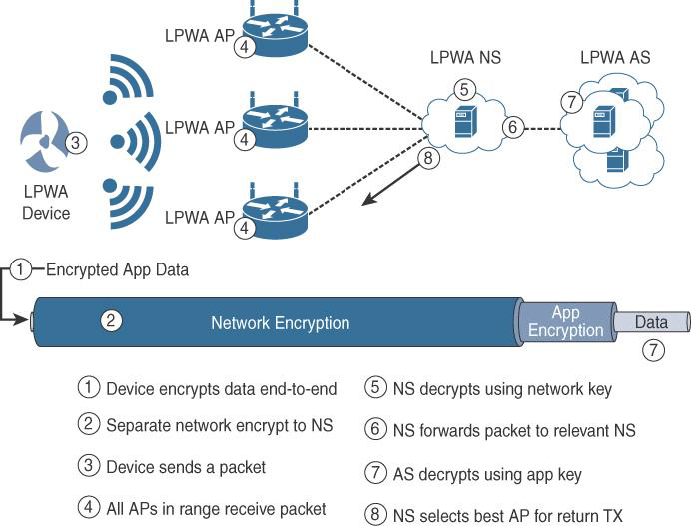
SECURITY

Slide 57
LoRaWAN endpoints attached to a LoRaWAN network must get registered and authenticated
--Activation by personalization (ABP)
--Over-the-air activation (OTAA)

Slide 58
NB-IoT and other LTE variations
LTE Cat0
LTE-M
- Lower receive bandwidth
- Lower data rate
- Half duplex mode
- Enhanced discountinous reception(eDRX)

Slide 59
NB-IoT
Extended Coverage GSM (EC-GSM), Ericsson proposal
Narrowband GSM (N-GSM), Nokia proposal
Narrowband M2M (NB-M2M), Huawei/Neul proposal
Narrowband OFDMA (orthogonal frequency-division multiple access), Qualcomm proposal
Narrowband Cellular IoT (NB-CIoT), combined proposal of NB-M2M and NB-OFDMA
Narrowband LTE (NB-LTE), Alcatel-Lucent, Ericsson, and Nokia proposal
Cooperative Ultra Narrowband (C-UNB), Sigfox proposal

Slide 60
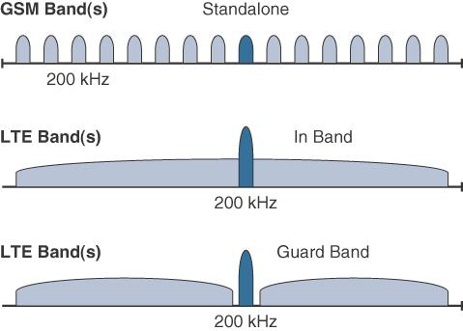
Standalone:
In-band
In-band

